Slide 1
Chapter 5
Kinematics of particle

Slide 2
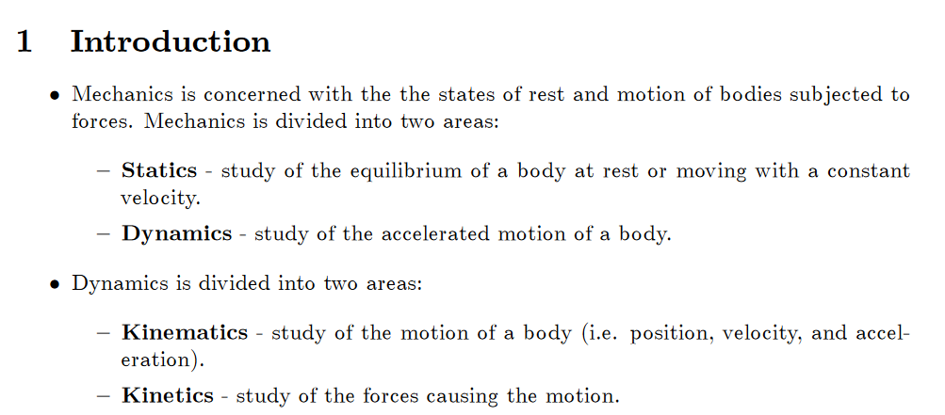

Slide 3
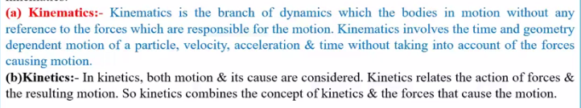

Slide 4
Rectilinear motion of a particles
When particles moves along a straight line the motion is said to be rectilinear motion.

Slide 5
Curvilinear motion of particle
It a particle moves along a curved path then the motion is said to be curvilinear motion of particle.

Slide 6
Rectilinear motion of a particles

Slide 7
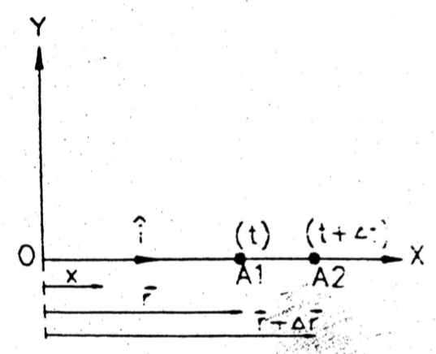

Position velocity and acceleration
Consider a particle moving in a straight line.
Position of particle is given by x .
Position vector of particle is given by $\vec{r }$= x$\hat{i}$
t+Δt

Slide 8
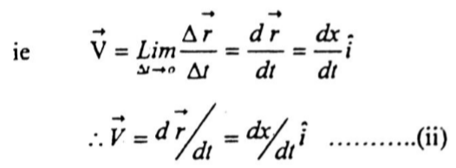
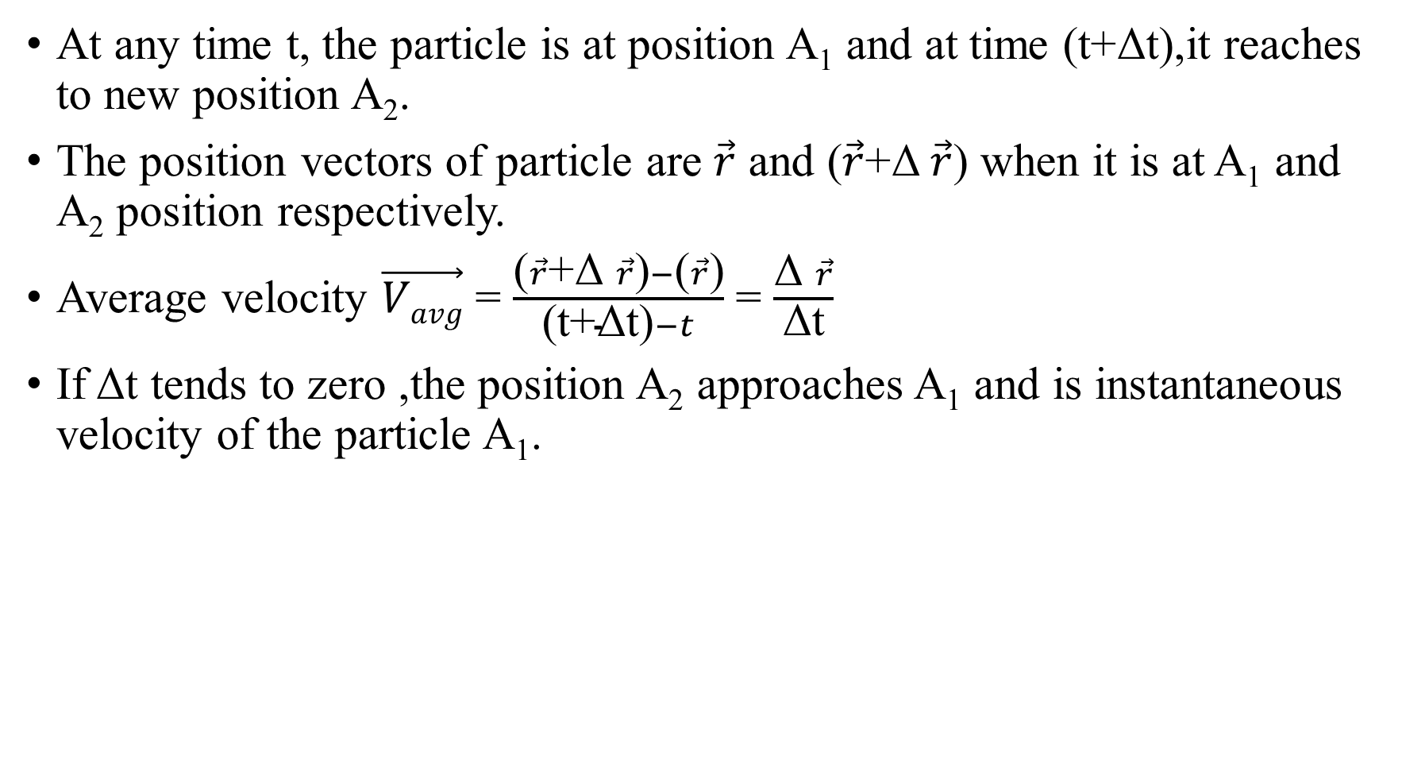
At any time t, the particle is at position A₁ and at time (t+Δt),it reaches to new position A₂.
The position vectors of particle are $\vec{r}$ and ($\vec{r}$+Δ$\vec{r}$) when it is at A₁ and A₂ position respectively.
Average velocity $\vec{Vavg}$ = $\frac{\text{(}\vec{r}\text{+}\text{Δ} \vec{r}\text{)}−\text{(}\vec{r}\text{)}}{\text{(}\text{t}\text{+}\text{Δ}\text{t}\text{)}−t}$ = $\frac{\text{Δ} \vec{r}}{\text{Δ}\text{t}}$
If Δt tends to zero ,the position A₂ approaches A₁ and is instantaneous velocity of the particle A₁.

Slide 9
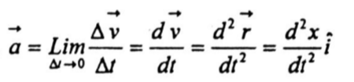
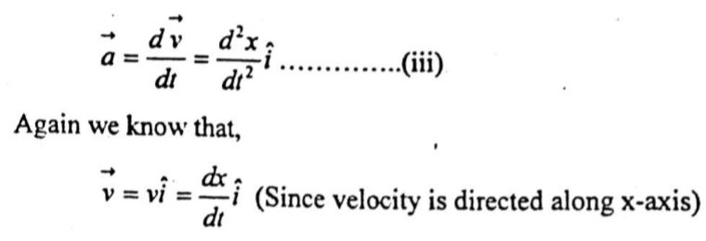

Average acceleration is rate of change of velocity ,
$\vec{a}$_{avg} = $\frac{\vec{Δv}}{Δt}$
Instantaneous acceleration,

Slide 10
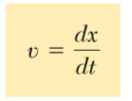

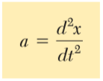
(In scalar form)

Slide 11

On elimination of dt from above equation
$$\frac{dx}{v}= \frac{dv}{a}$$
$$∴a=v\frac{dv}{dx}$$

Slide 12
Rectilinear motion of particle(key note)
When a particle moves along a straight line of the motion , it is said to be rectilinear motion.
In rectilinear motion when particles moves along straight line there are three possibilities:
if particles move along straight line with constant velocity then motion is called as uniform motion(as velocity is constant acceleration of particle is zero)
i.e uniform motion (v= constant,a=0)
S=x=y=ut………………….(a)

Slide 13
If during motion, velocity doesnot remain constant i.e when it change with respect to time ,dv/dt and if this rate of increase or decrease of velocity wrt time if it is constant ,i.e acceleration remains constant , then the motion is called uniformly accelerated motion.
uniformly accelerated motion (a = constant)
1. v = u + at……b)
2. v² = u² + 2as……c)
3. S = ut + ½ at²………d)

Slide 14

Motion with variable acceleration(a$≠$constant)
Equation b),c),d) not valid.

Slide 15
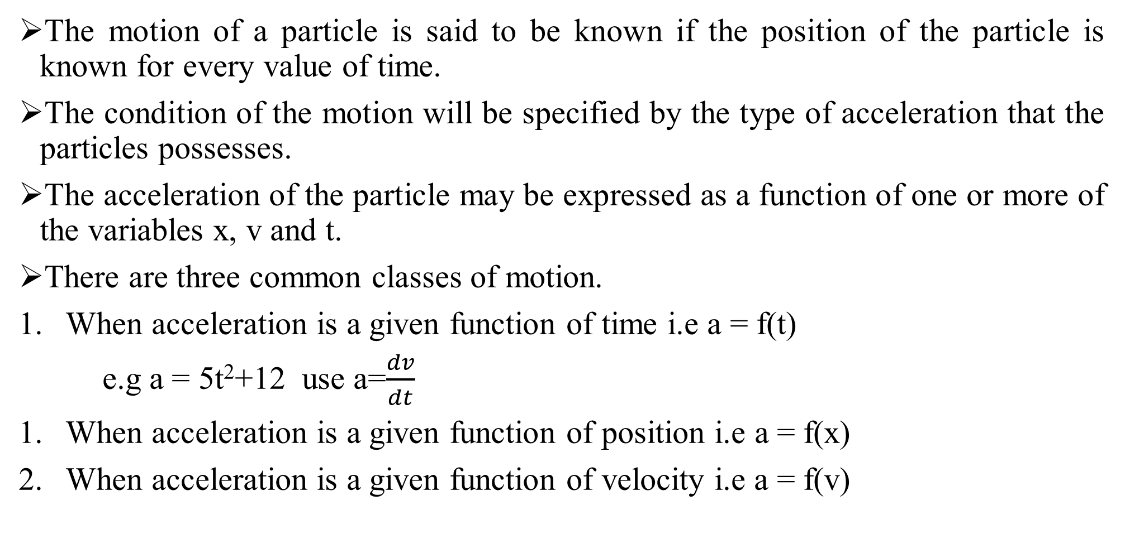
Determination of motion of particles
The motion of a particle is said to be known if the position of the particle is known for every value of time.
The condition of the motion will be specified by the type of acceleration that the particles possesses.
The acceleration of the particle may be expressed as a function of one or more of the variables x, v and t.
There are three common classes of motion.
When acceleration is a given function of time i.e a = f(t)
e.g a = 5t²+12 use a=$\frac{dv}{dt}$
When acceleration is a given function of position i.e a = f(x)
When acceleration is a given function of velocity i.e a = f(v)

Slide 16

For 2 case use, when acceleration is given function of position E.g a = x²+5x+12

Slide 17
For 3 case, when acceleration is given function of velocity
E.g a = 9v³+10v+5
Use

Slide 18
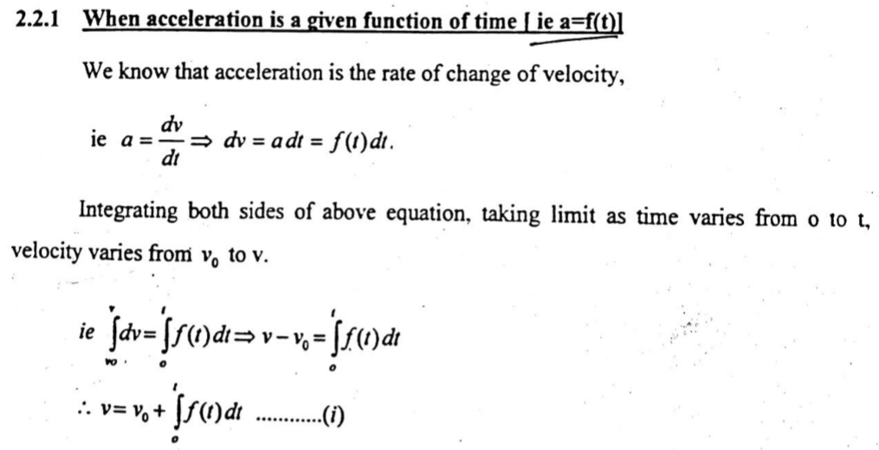

Slide 19
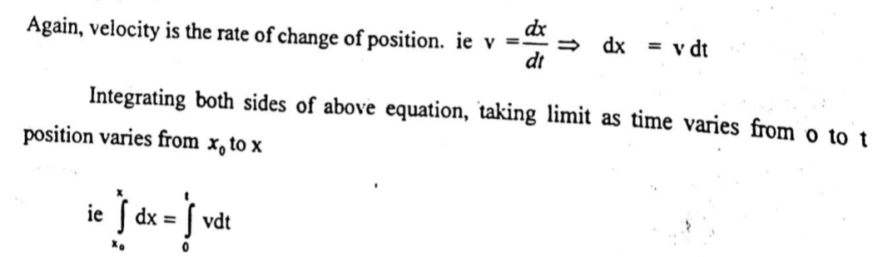
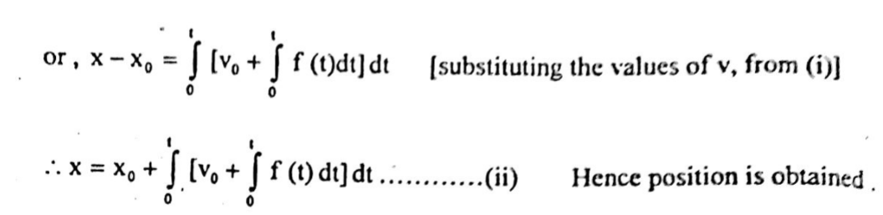

Slide 20
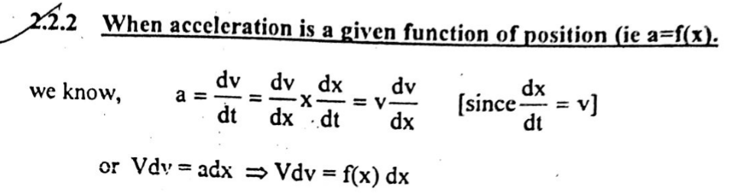

Slide 21
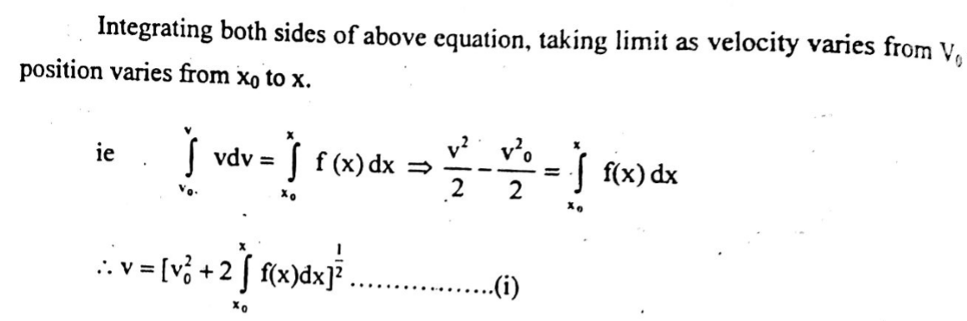

Slide 22
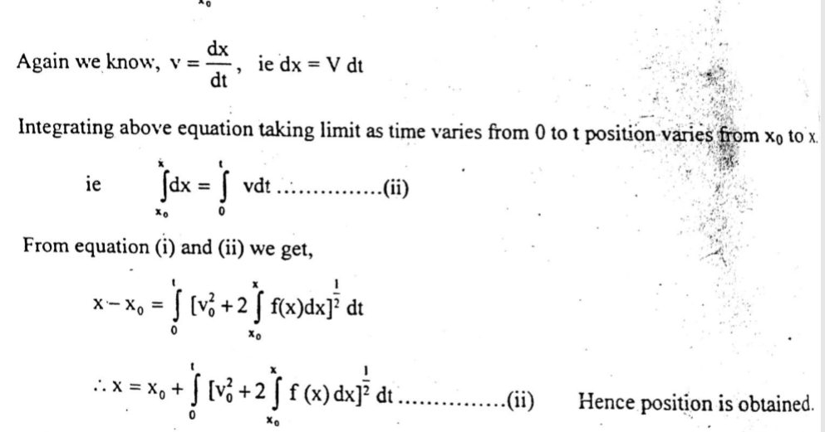

Slide 23
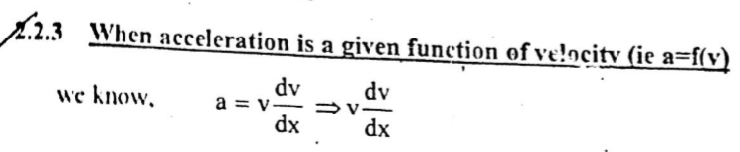
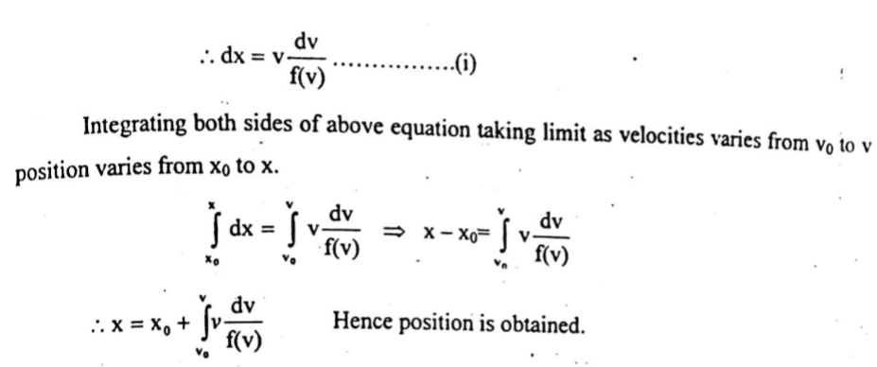

Slide 24
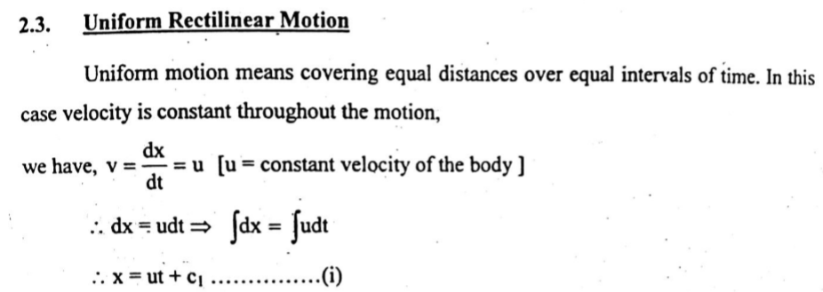
Uniform rectilinear motion -It means covering equal distances over intervals of time. - Velocity is constant throughout the motion. Hence acceleration is zero for every value of t.

Slide 25
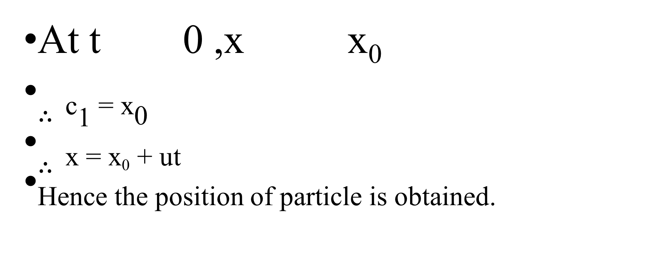
At t 0 ,x x₀
$∴$_{c1 = x0}
$∴$_{x = x0 + ut}
Hence the position of particle is obtained.

Slide 26
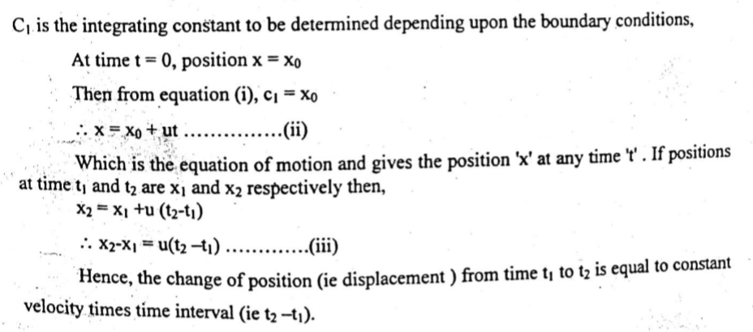

Slide 27
Uniform acceleration rectilinear motion:
If the change in velocity of a particle is constant then the motion is called uniformly accelerated rectilinear motion.
In this motion acceleration is constant or velocity varies linearly.

Slide 28
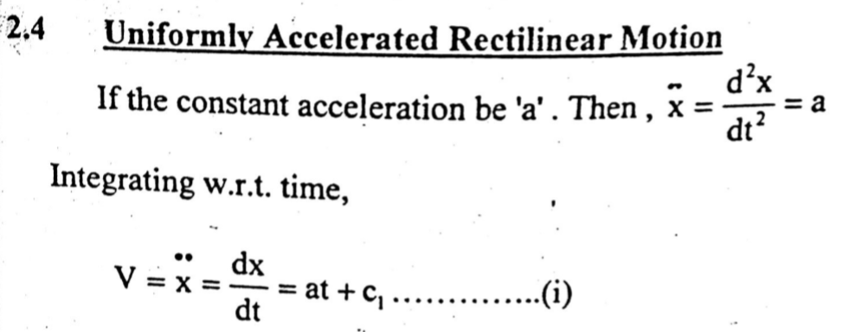

Slide 29
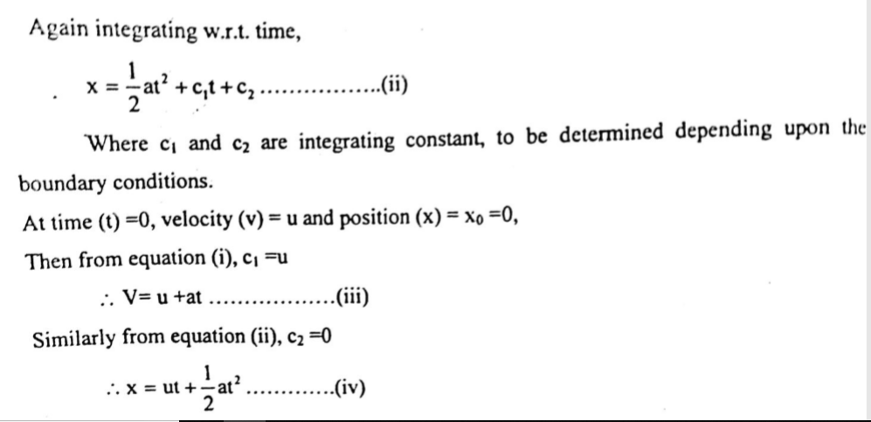

Slide 30
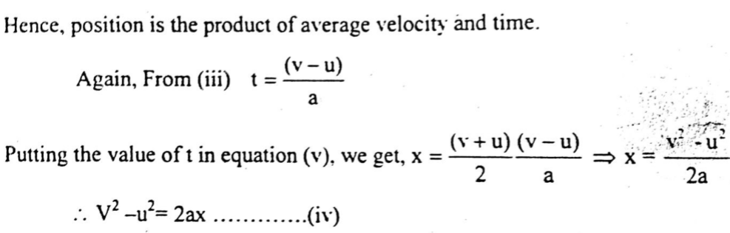

Slide 31
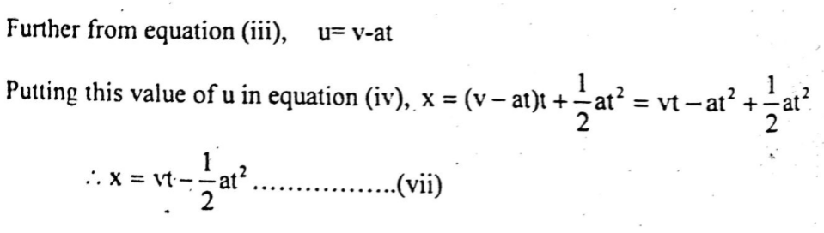

Slide 32
Motion of several particles
When several particles move independently along the same line, independent equations of motion may be written for each particle.
Can be described as below
Relative motion of two particles
Dependent motion

Slide 33
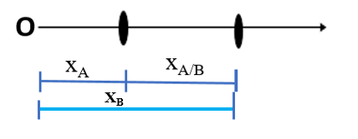
Relative motion of two particles
Let position coordinate of A = x_{A}
Let position coordinate of B= x_{B}
Relative position of B with respect to A is x_{A/B} or x_{AB}
x_{B/A} = x_{B} – x_{A}
x_{B}= x_{A}+x_{B/A}
Differenciating:
V_{B} = V_{A} +V_{B/A}
Again Differenciating:
a_{B} = a_{A} +a_{B/A}

Slide 34
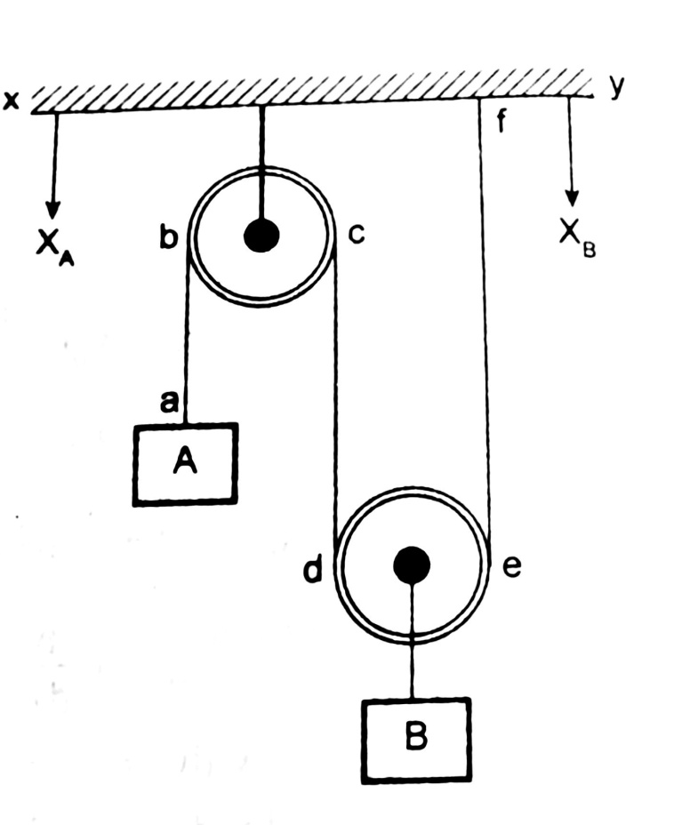
Dependent Motion
If the position of a particle depend upon the position of another or several other particles, the motion are said to be dependent.
Consider a pulley system as shown in fig below
Length of rope abcdef is constant
Let XY be reference position
Let the position of A be x_{A}
Let the position of B be X_{B}

Slide 35
From fig,
The position of block B depends upon the position of block A.
Here,
ab+bc+cd+de+ef = constant
bc and de remains fixed, since they are wrapped around the pulley
ab+cd+ef = constant

Slide 36
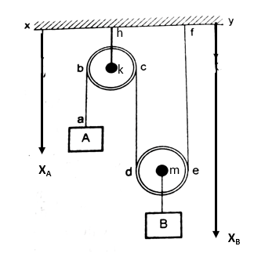
(ab+kh)+(dc+kh+mb)+(mb+ef)=constant+2kh+2mb
x_{A}+x_{B}+X_{B} = constant
x_{A}+2x_{B} = constant
Differenciating it,we get,
V_{A}+2V_{B} = 0
Again Differenciating it,we get,
a_{A}+2a_{B} = 0

Slide 37
Single degree of freedom dependent motion
Here only two blocks can move up and down, the position of only one block can be arbitrary.

Slide 38
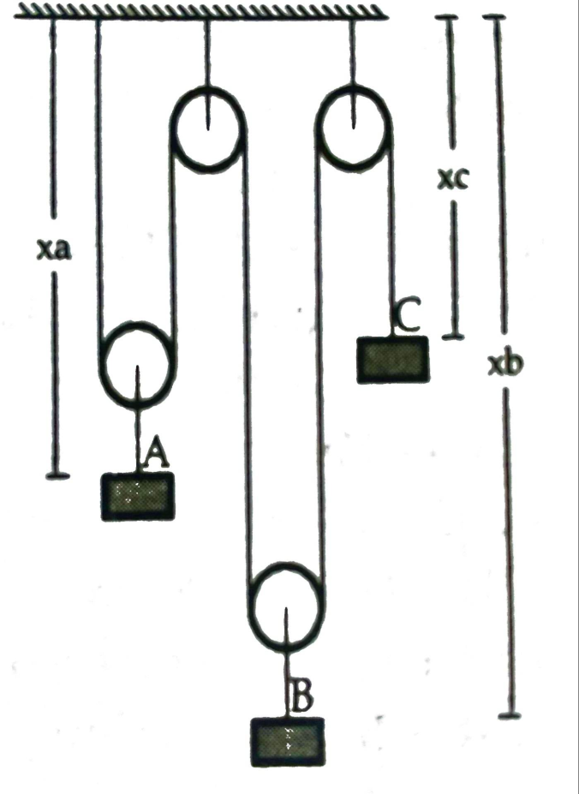
Multi Degree of freedom dependent motion
Consider a pulley system as shown in fig.
At any instant we can fix the position of any two blocks at any distance from datum.
So this system has got two degree of freedom.
From the figure, we can derive,
2x_{A}+2x_{B} + x_{C} = constant
Differenciating it, we get,
2V_{A}+2V_{B} + V_{c} = 0
Again Differenciating it,we get,
2a_{A}+2a_{B} + a_{C =} 0

Slide 39
Curvilinear motion:
Curvilinear motion is the motion of an object when it moves along a curved path.
Example:
A train moving on a curved track
Turning of a Car
Roller Coaster
Cycling
Running on Curved Race Track

Slide 40
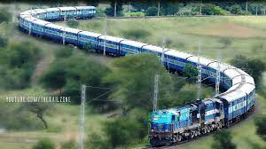

Slide 41
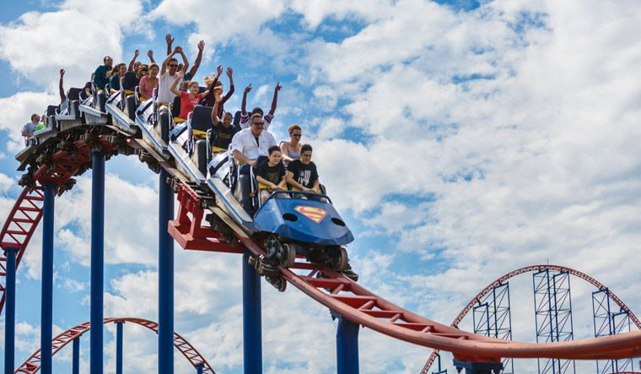
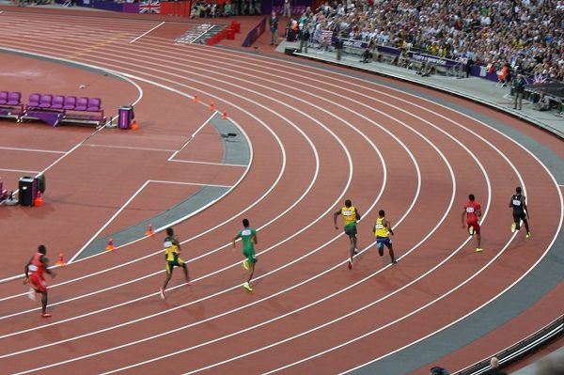
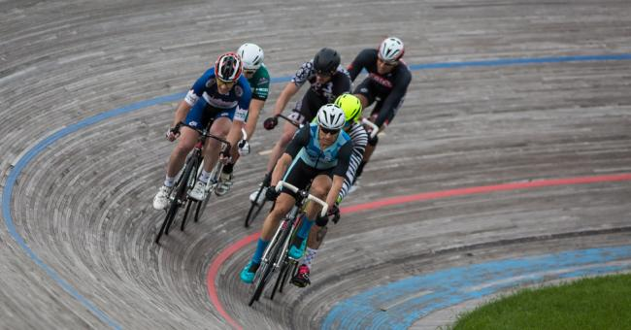
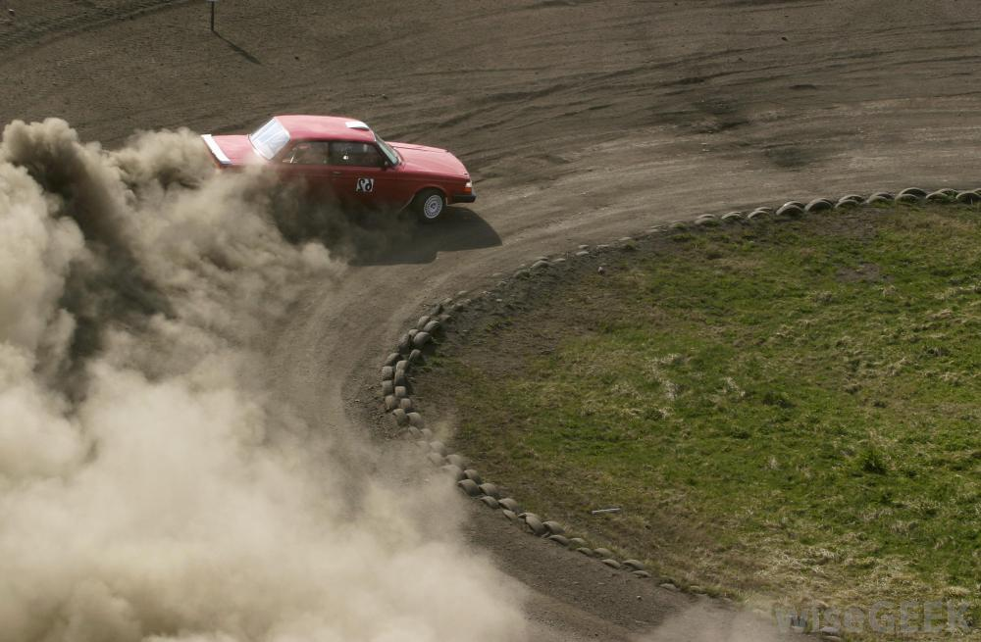

Slide 42
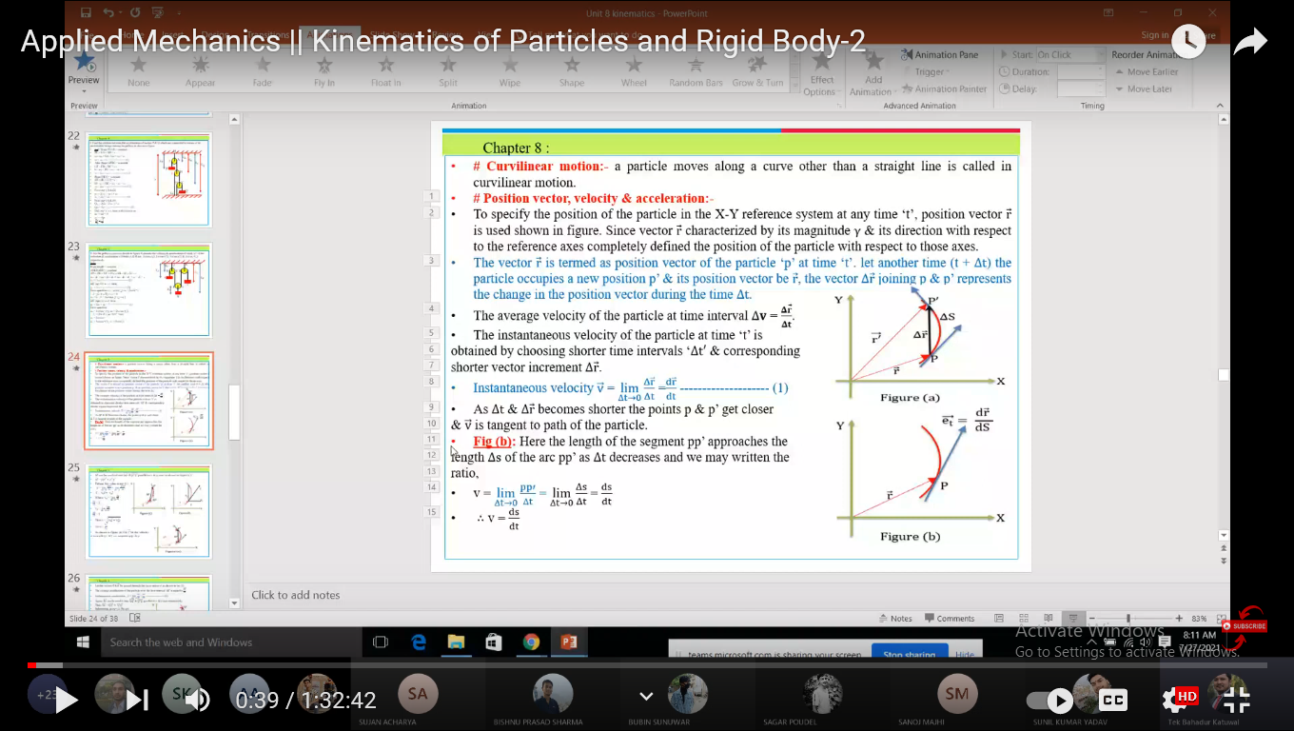

Slide 43
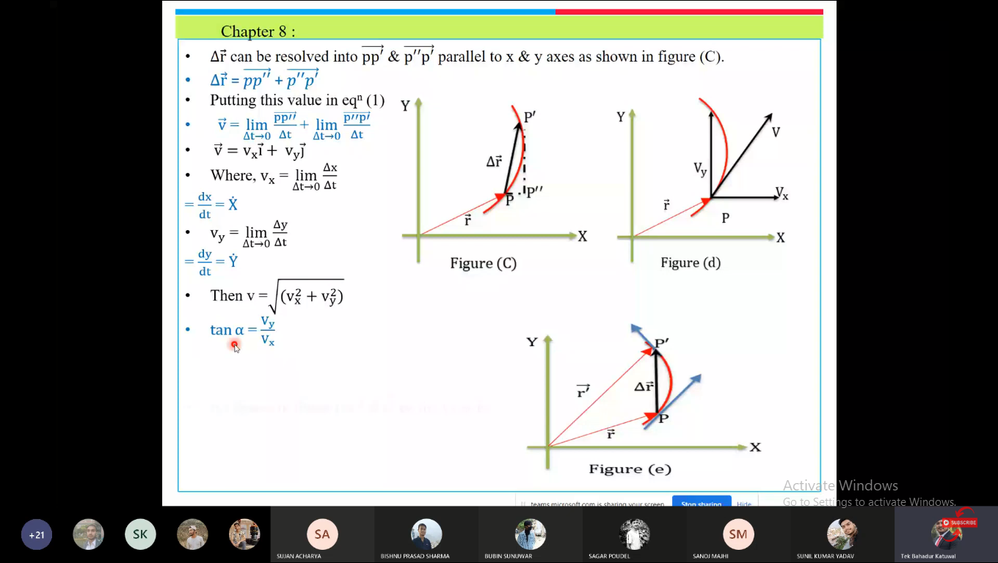

Slide 44
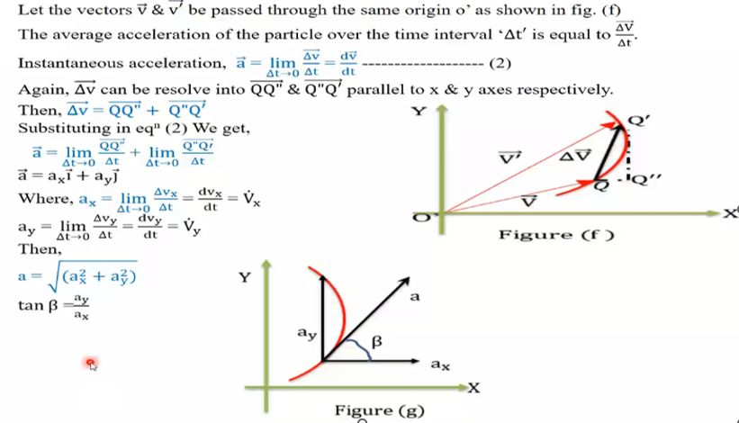

Slide 45
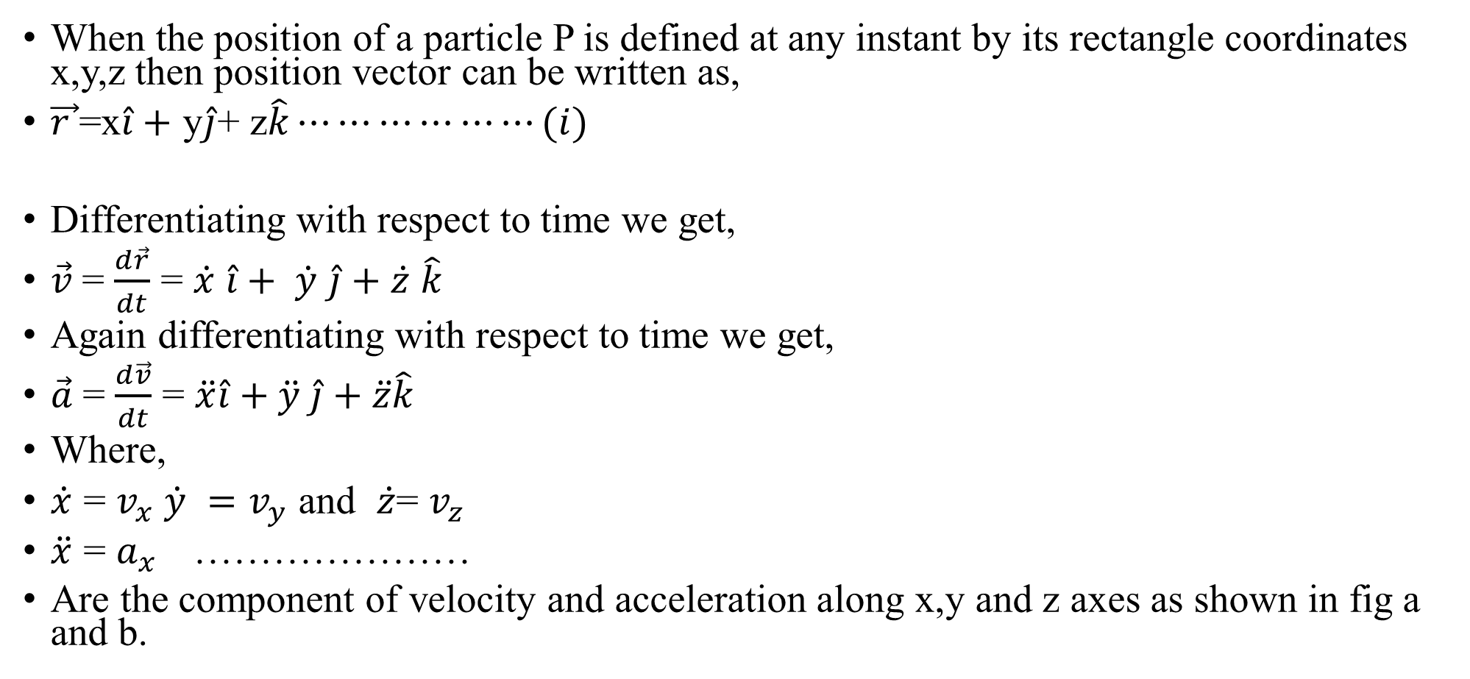
Rectangular Components of Velocity and Acceleration
When the position of a particle P is defined at any instant by its rectangle coordinates x,y,z then position vector can be written as,
$\vec{r }$=x$\hat{i}+$ y$\hat{j}$+ z$\hat{k}⋯⋯⋯⋯⋯⋯(i)$
Differentiating with respect to time we get,
$\vec{v}$= $\frac{d\vec{r}}{dt}$ = $\dot{x}\hat{i}+ \dot{y}\hat{j}+\dot{z}\hat{k}$
Again differentiating with respect to time we get,
$\vec{a}$= $\frac{d\vec{v}}{dt}$ = $\ddot{x}\hat{i}+\ddot{y} \hat{j}+\ddot{z}\hat{k}$
Where,
$\dot{x}$ = $v_{x} \dot{y} =v_{y} \text{and} \dot{z}$= $v_{z}$
$\ddot{x}$ = $a_{x}$…………………
Are the component of velocity and acceleration along x,y and z axes as shown in fig a and b.

Slide 46
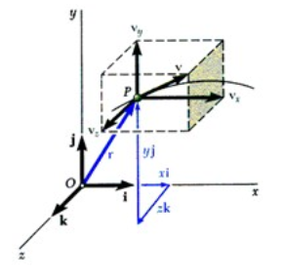
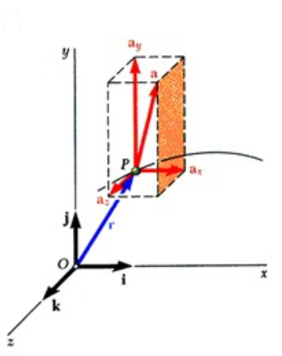

Slide 47
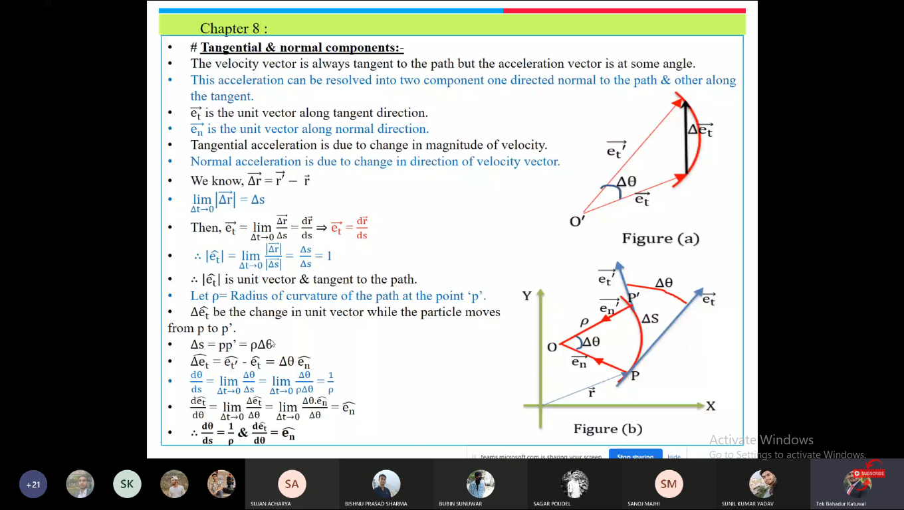
Tangential and normal components:

Slide 48
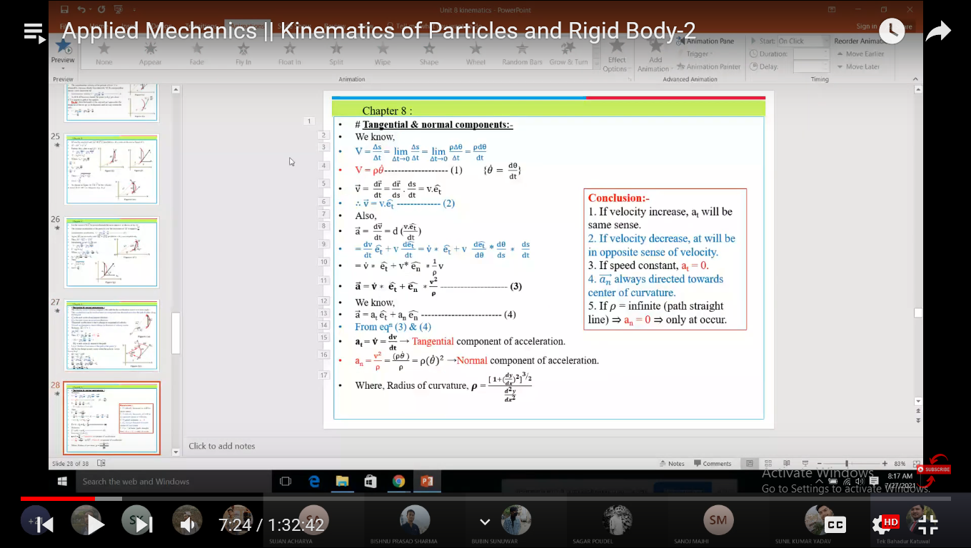

Slide 49
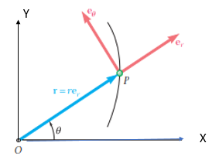
Radial and Transverse component
Sometimes it is easier to use polar coordinates to describe the curvilinear motion of particles.
In this system the position or location of the particle is defined by r and ϴ where r is distance from the origin and ϴ is the angle by the position vector on x axis as shown in fig.a.

Slide 50

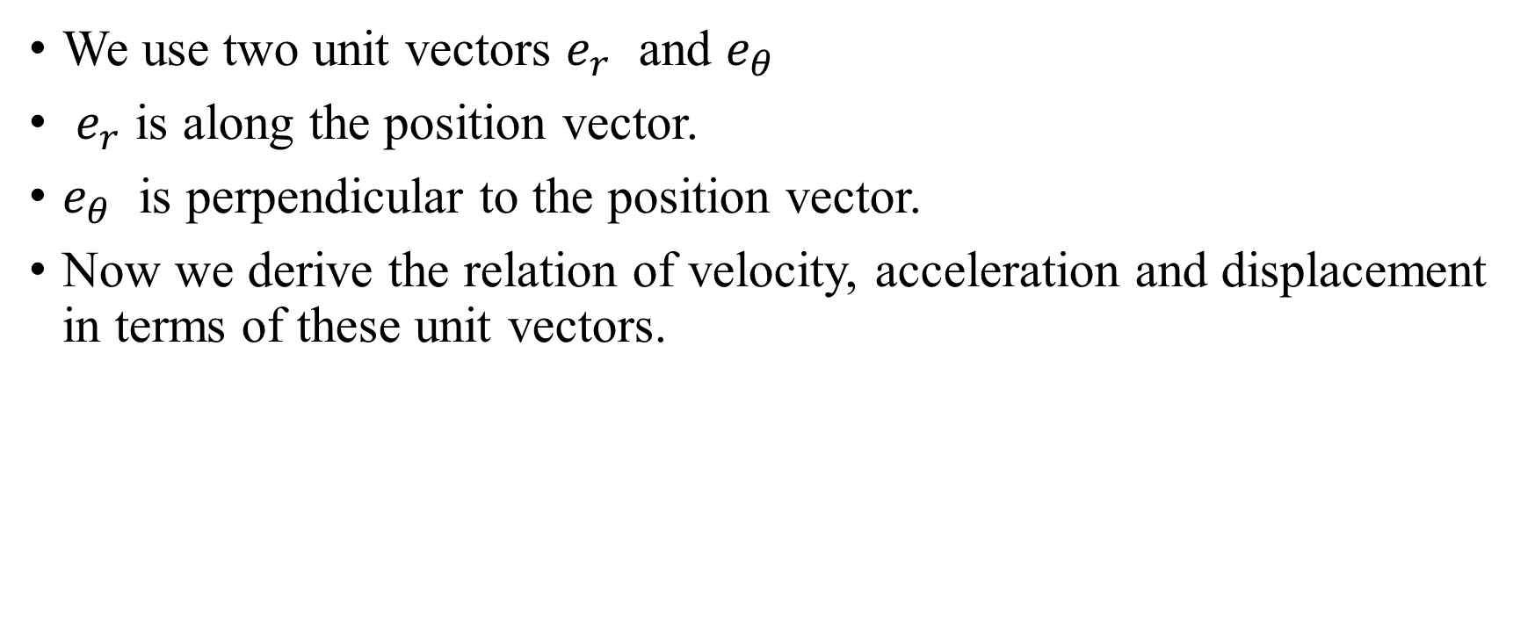
We use two unit vectors $e_{r}$ and $e_{θ}$
$e_{r}$ is along the position vector.
$e_{θ}$ is perpendicular to the position vector.
Now we derive the relation of velocity, acceleration and displacement in terms of these unit vectors.

Slide 51


U

Slide 52


To obtain the velocity v of the particle P, we express the position vector r of P as the product of the scalar r and the unit vector er and differentiate with respect to time t.

Slide 53
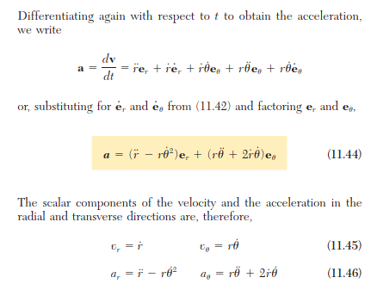

Slide 54
